Slide 1
Multi-Agent Chatbot
Generative
AI
Abhishek Sahoo, Ayush Chakraborty, Nishant Pandey, Vikram Pathak, Yash Joglekar

Slide 2
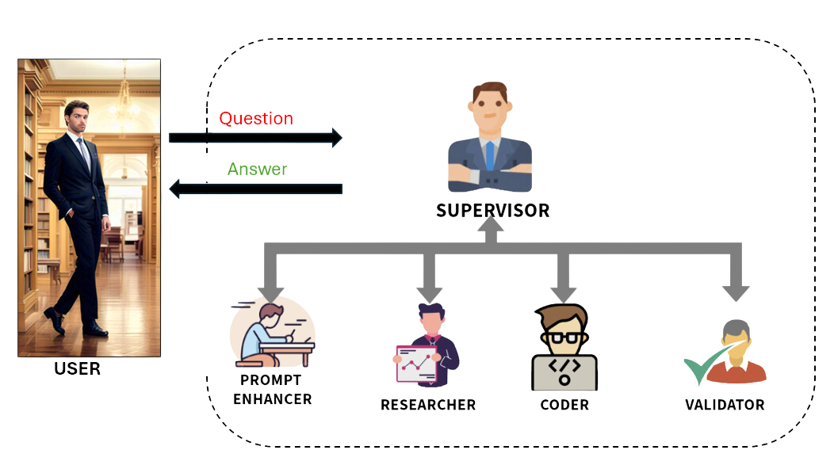
Introduction
The Multi-Agent Chatbot for Gen AI improves response accuracy and efficiency by leveraging specialized agents for task-specific processing and real-time knowledge retrieval
A Supervisor Agent intelligently routes queries to the Enhancer (prompt refinement), Researcher (RAG-based retrieval), Coder (technical execution), and Validator (quality control)
The chatbot supports Zero-Shot, One-Shot, Few-Shot and RAG Learning, enhancing adaptability and context awareness for diverse user queries

Slide 3
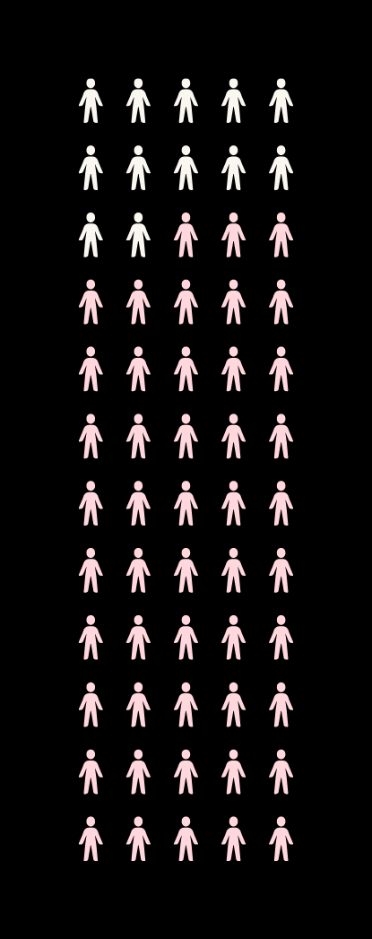
Why multiple agents?
Parallel and Specialized Task Handling: Each agent focuses on a specific function—query enhancement, research, coding, or validation—enabling faster and more accurate responses
Scalability and Modular Design: Agents can be added or modified independently, allowing the chatbot to adapt to new domains such as finance, healthcare, and legal applications
Improved Accuracy and Task Handling: By routing queries to the most appropriate agent, the system ensures domain-specific precision and reduces incorrect responses.

Slide 4

System Architecture
Supervisor Agent – Routes user queries to the appropriate agent.
Enhancer Agent – Refines vague or incomplete user inputs for better clarity.
Researcher Agent – Fetches external knowledge from sources like Wikipedia, Arxiv, or search engines.
Coder Agent – Executes coding tasks and technical computations.
Validator Agent – Ensures responses are accurate and contextually relevant before returning them to the user.

Slide 5
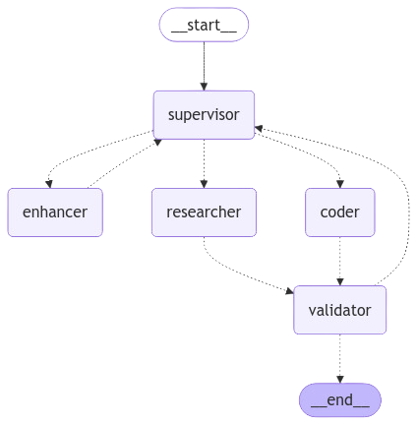
Workflow
User Query → Processed by the Supervisor Agent.
Task Routing → The Supervisor assigns tasks to the most relevant agent.
Processing → Agents collaborate and generate responses.
Validation → The Validator Agent ensures quality control.
Final Response → A refined, and accurate answer is presented to the user.
Example Use Cases:
Weather Query → The Researcher Agent retrieves real-time weather data.
Python Code Execution → The Coder Agent executes and verifies results.

Slide 6

Learning Approaches in the Chatbot
Zero-Shot Learning: The model generates responses without prior examples.
Example: "What is the capital of France?" → "The capital of France is Paris."
One-Shot Learning: The model is given one example before answering a new question.
Example: "Who wrote 1984?" → "George Orwell wrote 1984."
New Question: "Who wrote Hamlet?" → "William Shakespeare wrote Hamlet."
Few-Shot Learning: The model is given multiple examples before answering.
Example 1: "Who wrote 1984?" → "George Orwell wrote 1984."
New Question: "Who painted the Mona Lisa?" → "Leonardo da Vinci painted the Mona Lisa."

Slide 7

RAG Integration
Why RAG?
Standard LLMs lack real-time knowledge beyond training data.
RAG enables dynamic knowledge retrieval from sources like Wikipedia and Arxiv.
How RAG Works in This Chatbot
The chatbot retrieves relevant documents from Wikipedia or Arxiv.
The information is processed and used to answer user queries.
The chatbot combines retrieval with generation for factually accurate responses.
Example:
Query: "Impact of climate change on agriculture?"
RAG Output: "Climate change affects agriculture through rising temperatures, changes in precipitation, and extreme weather events. Studies show that crop yields may decline by 10-25% by 2050 unless adaptive measures are implemented.

Slide 8

Key Challenges
Handling Conflicting Outputs:
Ensuring that multiple agents' responses are merged cohesively without contradictions.
Efficiency & Low Latency:
Optimizing execution to minimize processing delays while ensuring high response quality.
Task Prioritization:
Ensuring that the Supervisor Agent intelligently assigns tasks to the most relevant agent.
Scalability Issues:
As the system expands, maintaining performance across multiple domains and knowledge bases.

Slide 9

Future Scope
More Specialized Agents:
Introducing new domain-specific agents (e.g., legal, medical, financial).
Integration with Advanced Knowledge Bases:
Expanding sources beyond Wikipedia and Arxiv for real-time and verified information retrieval.
Performance Optimization:
Using asynchronous processing to reduce latency and improve speed.
Richer Natural Language Understanding (NLU):
Enhancing prompt refinement and multi-turn conversations using advanced deep learning models.

Slide 10
Conclusion
The Multi-Agent Chatbot enables accurate, efficient, and scalable AI-driven conversations.
By leveraging specialized agents, the chatbot outperforms traditional models in task handling and precision.
The future roadmap includes expanding agent capabilities, integrating richer knowledge bases, and optimizing performance for real-world applications.

Slide 11
THANK YOU

